Slide 1
The Future of Center-Based Multidisciplinary Engineering Research
Pramod Khargonekar
Assistant Director for Engineering
National Science Foundation
The National Academies
Committee on the Future of Center-Based, Multidisciplinary Engineering Research
December 14, 2015

Slide 2
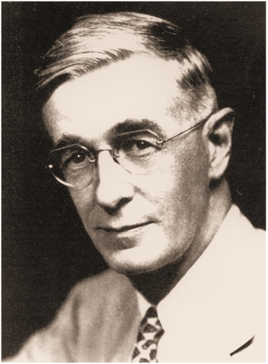
Science offers a largely unexplored hinterland for the pioneer who has the tools for his task. The rewards of such exploration both for the Nation and the individual are great. Scientific progress is one essential key to our security as a nation, to our better health, to more jobs, to a higher standard of living, and to our cultural progress.
“to promote the progress of science; to advance the national health, prosperity, and welfare; to secure the national defense…” NSF Act, 1950

Slide 3
NSF ENG: Investing in engineering research and education and fostering innovations for benefit to society
Research
Education
Industry Collaboration
Societal Benefits

Slide 4
Larger Context
Employment and Wages:
Productivity, innovation, economic growth, sustainability, long-term competitiveness
Mega problems:
Food, health, energy, water, security, education, infrastructure, …
Globalization:
Flows of components, products, services, knowledge, and people
People and talent:
Stubborn long-standing issues in STEM talent, diversity, and education
Federal support of research

Slide 5
Top Engineering Achievements of the 20th Century
1. Electrification
2. Automobile
3. Airplane
4. Water Supply and Distribution
5. Electronics
6. Radio and Television
7. Agricultural Mechanization
8. Computers
9. Telephone
10. Air Conditioning and Refrigeration
11. Highways
12. Spacecraft
13. Internet
14. Imaging
15. Household Appliances
16. Health Technologies
17. Petroleum and Petrochemical Technologies
18. Laser and Fiber Optics
19. Nuclear Technologies
20. High-performance Materials
Source: National Academy of Engineering

Slide 6
What will be on that list for the 21st Century?

Slide 7
Context for this NAE Study
NSF established the Engineering Research Centers program in 1984
Focus on multidisciplinary engineering research, education, and workforce development in partnership between academe and industry
Much has changed since 1984
And, doubtless, much more will change in the next 30 years!

Slide 8
Background on the ERC Program

Slide 9
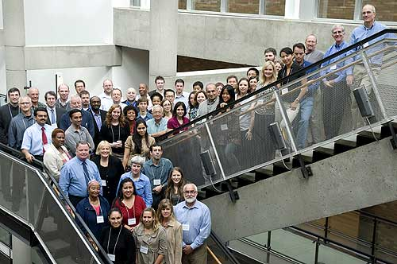
Engineering Research Centers program was launched with the GOAL:
“to further the development of fundamental knowledge in engineering fields that will
Enhance the competitiveness of the U.S. and
Prepare engineers to contribute through better engineering practice.”
Image courtesy NSF

Slide 10
Distinguishing Features of an ERC
Compelling vision for an engineered system at the cusp of discovery and innovation for societal impact
Integrated program from exciting fundamentals research to proof-of-concept systems test beds
A 10-year strategic plan that is driven by engineered systems barriers and powerful fundamental insights
Innovative plan to develop engineering graduates with the skills set to be highly effective in industrial practice and creative innovators in a global economy throughout their careers
Innovative plan to accelerate the use of ERC-generated technology and processes in industry/practice
EEC
Notes:
A typical successful ERC is supported for 10 years at $4M/year from NSF, often leveraged by additional funds provided by industry and often other agencies. The ERC vision should be consistent with the life of the center, i.e., about 10 years – that is, one expects that some novel translational effort is expected will be achieved within 10 years. A research program that extends far beyond 10 years would not be consistent with the goals of this program (thus the wording “at the cusp of discovery and innovation.”).
ERC projects are NOT product development projects, i.e. projects in which the fundamental knowledge is well known and engineering work is put together to develop technologies and products. ERC projects will have system-driven challenges that will motivate significant and exciting potentially transformative fundamental research that will enable the technology and overall system that the ERC has proposed. The system-level motivator and fundamental research will enabled the technology level and system level test-beds. The system level research motivated by societal and/or economic needs relevant to sustain UC competitiveness will naturally be cross-disciplinary, another characteristic of a successful ERC.
The lack of system-level “grand challenge” driver leading the technology development and fundamental research re the hallmarks of successful ERC projects.

Slide 11
ERC Evolution Timeline
First Gen-2 ERCs awarded - Sept 1994
Sep 8
Total degrees granted to ERC students passes 10K
Total ERC funding (all centers, all sources) passes $150M
Jun 1
3-plane strategic planning concept implemented
Sep 1
First six ERCs awarded (Gen-1) - March 1985
Diversity plan included in ERC cooperative agreements
Jun 1
Apr 1
ERC program annual meetings initiated
ERC Best Practices Manual (1st ed.) published
Mar 1
Longtime ERC Program Leader Lynn Preston steps down
Jun 1
Dec 1
Oct 28
1984
1984
1988
1992
1996
2000
2004
2008
2012
2015
First site visits with external reviewers conducted
Apr 15
Visiting “Consultancies” established for ADs and ILOs
Jan 30
First five Gen-3 ERCs awarded - Sept 2008
Sep 8
Today
Dec 16
NAE study conducted
ERC Program established
Sep 1
ERC Association website launched
Jan 15
Student Leadership Councils required
Mar 2
47 total Gen-1 & -2 ERCs and EERCs formed
Jan 1
SWOT process implemented
Apr 1
21 total Gen-1 ERCs established, 4 terminated
Sep 1
= Milestone
= Event

Slide 12
Gen 1 to Gen 2 Major Changes (underlined)
At least one academic core partner required from 1998 on
Guiding strategic vision for transforming engineered systems and developing a globally competitive and diverse engineering workforce
Strategic plans for research, education, and diversity to realize the vision
Cross-disciplinary research program from discovery to innovation
Education program integrating research and education
Outreach to precollege and other university students and teachers/faculty
Partnership with industry to formulate and evolve the strategic plan, strengthen research and education, speed technology transfer
Leadership infrastructure, cohesive interdisciplinary team, management systems
Cross-institutional commitment to facilitate and foster the interdisciplinary culture and diversity of the ERC

Slide 13
Gen 2 to Gen 3 Major Changes
Gen-3 ERCs bridge discovery to innovation by expanding the ERC culture to:
Support translational research with small firms to speed innovation
Partner with economic development organizations to foster entrepreneurship
Develop engineers who are more creative & innovative
Partner with foreign universities to provide cross-cultural, global research and education experiences
Establish long-term pre-college partnerships to attract young students to engineering

Slide 14
Current ERC Solicitation (NSF 15-589)
What is the compelling new idea and how does it relate to national needs?
Why is a center necessary to tackle the idea?
How will the ERC's infrastructure integrate and implement research, workforce development and innovation ecosystem development efforts to achieve its vision?

Slide 15
ERC Program Evaluations and Reports
General
2007 Annual Meeting Report: Designing the Future ERC
Post-Graduation Status of Engineering Research Centers - 2010
Engineering Research Centers 2005-2006 Program Report
Designing the Future Generation of NSF Engineering Research Centers: Insights from Worldwide Practice (report of the Science and Technology Policy Institute, 2007)
The Impact of Engineering Research Centers on Institutional and Cultural Change in Participating Universities, 2001
Documenting Center Graduation Paths, 2000
The ERC Program: An Assessment of Outcomes and Benefits, 1997

Slide 16
ERC Program Evaluations and Reports
Education & Workforce Development
Undergraduate and Graduate Education Activities of Current Engineering Research Centers - 2006
Post-graduation Status of ERC Education Programs – 2002
Innovation & Industrial Collaboration
IAB Role in ERCs: A SWOT - 2012
Innovations: ERC-Generated Commercialized Products, Processes, and Startups - 2010
Engineering Innovation: Strategic Planning in NSF-funded ERCs - 2007
The Economic Impact on Georgia of Georgia Tech’s Packaging Research Center - 2004
The Impact on Industry of Interaction with Engineering Research Centers - 2004

Slide 17
Key Issues – General ERC Operations
Let’s see what emerges here from recent years (e.g., GEN 3 only)
If need be you can have up to two slides for each category (R, E&W, I&I)
Call my cell 972-672-4450 if you need anything

Slide 18
Key Issues – General ERC Operations
Let’s see what emerges here from recent years (e.g., GEN 3 only)
If need be you can have up to two slides for each category (R, E&W, I&I)
Call my cell 972-672-4450 if you need anything

Slide 19
Key Issues – ERC Research

Slide 20
Key Issues – Education & Workforce Development

Slide 21
Key Issues – Education & Workforce Development

Slide 22
Key Issues – Innovation & Industrial Collaboration

Slide 23
As we look to the future …

